Slide 1
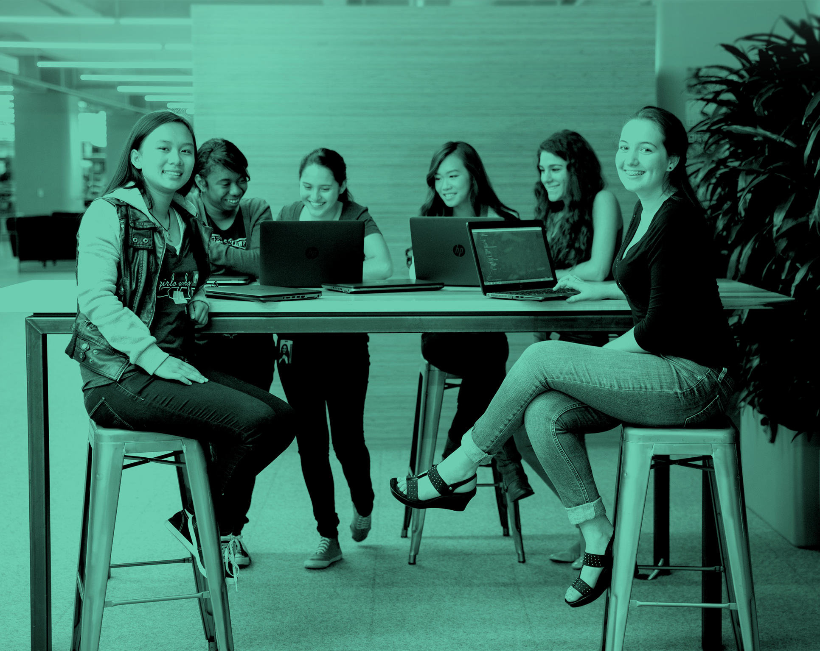
Girls Who Code Teacher Training
Welcome to Training
‹#›

Slide 2

Training Goals
Great teachers will be able to (GTWBAT)….
Get an overview of and practice using our resources
Participate in a positive learning environment as both a student and a teacher
Be able to articulate the program vision and goals, as well as the “moves” and decisions that will help them achieve those outcomes

Slide 3
Teacher Training Takeaways
Curriculum content and delivery methods
Planning structure and resources
Teaching moves
Expectations for building a safe classroom and resources to do so (Perception Institute)
Connections with GWC staff, fellow teachers and partners!
Notes:
Curriculum:
New topics this year (Django!)
Interactive
Instruction and planning:
Modeling techniques throughout the weekend
SIP classroom simulation
Diversity and Inclusion
Outside partner (Perception Institute)
Research based, social sciences, experience with teachers
Community Building:
Meet your team and site leads
PE panel

Slide 4
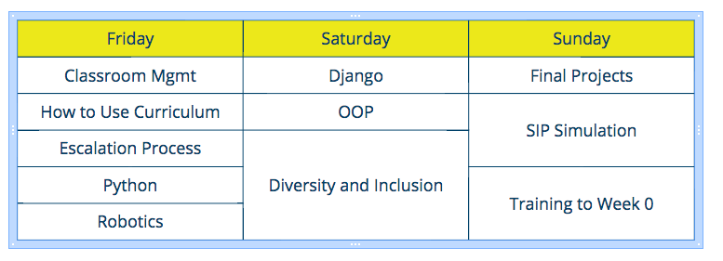
Things You’ll See A Lot...
I DO | WE DO | YOU DO
TEACHING
MOVE

Slide 5
AGENDA
Training Goals and Takeaways
GWC Mission
Educational Philosophy
Decision Making Framework
Expectations

Slide 6
Girls Who Code is a national non-profit organization working to close the gender gap in technology. Our programs educate, equip, and inspire girls with the computing skills they’ll need to pursue 21st century opportunities

Slide 7
What is SIP?
7 week immersive program for 11th and 12th grade girls
Introductory curriculum with final project capstone
Hosted by company/organization
Speakers and field trips
Full-time job for teaching teams

Slide 8
Educational Philosophy
More than Code
Sisterhood & Collaboration
Real-World Relevance & Impact
Notes:
More Than Code: Learning computational thinking and computer science cultivates girls’ interests and prepares them for long-term success in computer science.
Computer science is a diverse field that includes a way of thinking, planning, and problem solving in addition to programming. This approach, called computational thinking, is the foundation of our curriculum.
By focusing on computer science and computational thinking, girls develop a strong technical foundation that will empower them to learn new programming languages and quickly navigate a shifting technical landscape.
Our curriculum is regularly updated to remain relevant both to our girls’ interests and the state of the professional field.
Sisterhood & Collaboration: Positive and supportive environments both enable & sustain the learning process and longevity in computer science.
Girls-only educational environments that are collaborative in nature and focus on confidence remove systematic, historical barriers to access in computer science and foster a safe space to learn and explore.
A diverse, inclusive, and affirming community in the classroom creates a support system crucial to keeping girls in the CS field by hedging impostor syndrome and stereotype threat.
Our programs amplify the stories of women computer scientists of diverse backgrounds and abilities, who have been historically underrepresented, to provide role models and to rewrite the common understanding of “computer scientist”.
Real-World Relevance & Impact: Interest-based learning enables and empowers students to make an impact in their communities.
By using a project-based approach, girls are able to see how they can be creative with computer science and develop their own ideas.
By using an inquiry-based approach, girls are able to see how CS is relevant to both their own interests and their day-to-day lives.
By using problem solving through computational thinking, girls see the positive impact they can have on the world through computer science and how they can use technology to contribute to issues of social justice.

Slide 9
Decision Making Framework
Why?
Advocate for all students
Make your thinking visible
Build more than code
Notes:
Why?
Many priorities, possible incidents
Framework for addressing situations that is broad enough to encompass everything

Slide 10
Decision Making Framework
Advocate for all students
How can you meet the needs for the individual students in your classroom and the class as a whole?
Make your thinking visible
How can you show girls rather than tell them?
Build more than code
How can you create a classroom that exposes girls to computer science while building sisterhood?

Slide 11
Expectations
What We Expect From You | What You Can Expect From Us (How We Can Help!)
Belief that all girls can code Thirst for continuous improvement Fierce commitment to creating a environment where girls can be brave Flexibility and vulnerability to meet everyone in the classroom where they’re at (including yourself!) Relentless resourcefulness Investment in the success of every girl across the country | Belief in all of you Thirst for continuous improvement Fierce commitment to building community and facilitating learning for teachers across the country Thought partnership and perspective: we are in this together Responsiveness and availability Team spirit; your success is our success

Slide 12

ORGANIZATIONAL CHART
Reshma Saujani,
Founder and CEO
Development
Programs
Marketing
Education, Strategy, and Innovation
People,
Operations,
And Finance
Recruitment
Instructor Training and Support
Program Ops
Research
Education
Innovation

Slide 13
Questions?

